Slide 1
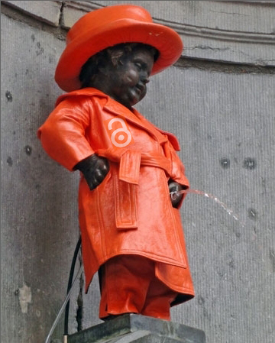
Open Access The Belgian approach
Eric Laureys
17-05-2016

Slide 2
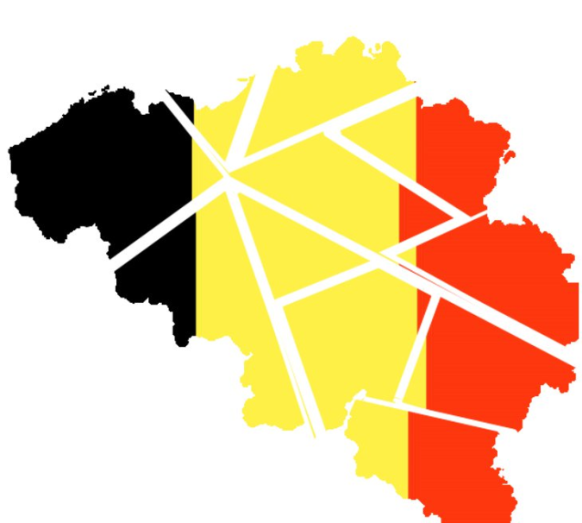
Institutional Belgium
Competences over research are scattered

Slide 3
Research in Belgium Industry (Applied Research Centres) : Regions

Slide 4
Research in Belgium Education (Universities) : Language Communities

Slide 5
Research in Belgium Research fields defined by national purpose and international commitments (Federal Research Institutions) : Federal Authority

Slide 6
Open Access policies in Belgium Flemish Community: • University repositories • Compulsory article archiving (1 year embargoes) • Encouraged archiving for non-FWO financed publications

Slide 7
Open Access policies in Belgium French Community: • University repositories • Compulsory archiving (6/12 month embargo) • Grant based APC-funding with cap (€ 500/article) • Cost for hybrid not eligible

Slide 8
Open Access policies in Belgium Federal Authority : • Has a central Repository • Compulsory archiving (6/12 month embargoes) • Grant based APC-funding with cap (€ 1300/article) • Quality and transparency requirements for Gold • Cost for hybrid not eligible • Evaluation based on Orfeo drawn bibliography

Slide 9
Open Access policies in Belgium Striking fact : • Enforcing Green OA • Fostering Fair Gold OA

Slide 10
Open Access policies in Europe Recent developments : Austria recommends : • Consortium based contracts with publishers • 1 year embargoes • 100% Gold OA by 2025 • (among others)

Slide 11
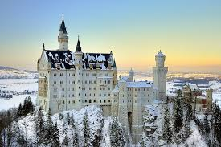
Open Access policies in Europe Recent developments : The Max Planck Society Berlin12 recommends : • Immediate access to journal articles • Convert resources from subscriptions into funds to support OA business models

Slide 12
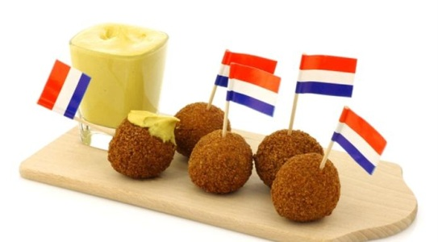
Open Access policies in Europe Recent developments : Dutch EU Presidency Conference advocates : • full access to publicly funded scientific publications by 2020 • more top down streamlining • more dialogue with the private sector

Slide 13
Open Access policies in Europe Basic reasons for support of APC based OA : • Green OA depends on the subscription system and does not push the system towards a substantial change. Gold OA is in a better position to achieve that. • Green OA is confusing (different versions, embargoes, data entry procedures…) • The goal is to reach a “fair gold”, without exaggeratedly high APCs.

Slide 14
Open Access policies in Europe Recent developments : • Marked tendency to create conditions favorable to Gold OA • Investment in Green OA treated marginally

Slide 15
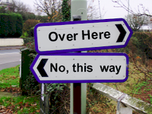
Belgian Open Access rationale Does this mean there is contradiction ?

Slide 16
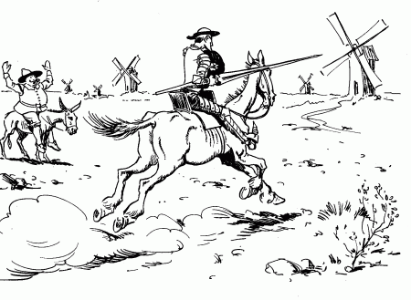
Belgian Open Access rationale No ! But Belgians feel that some aspects of OA deserve unabated attention as they are instrumental to the public sector’s mission.

Slide 17
Belgian Open Access rationale Such as : • Gold doesn't provide solutions for Grey Literature

Slide 18
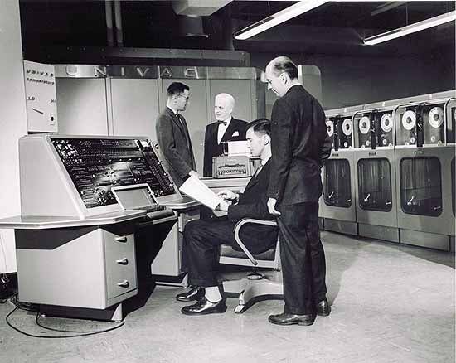
Belgian Open Access rationale Such as : • Private publishers cannot be expected to care for durable digital scientific heritage preservation, despite initiatives like Lockss or Portico.

Slide 19
Belgian Open Access rationale Such as : • Gold does not permit institutional bibliographic management.

Slide 20
Belgian Open Access rationale Such as : • Bringing about the dominance of the APC based business model will pave the way to commercial orientation of research, and what’s more by means of a harmful research evaluation system.

Slide 21
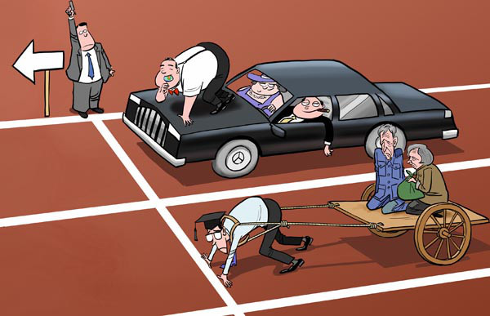
Belgian Open Access rationale Such as : • Publishing opportunities for authors in less endowed institutions or countries and in low budget disciplines will be limited by the APC based business model.

Slide 22
Belgian Open Access rationale Such as : • Institutional Repositories provide leverage to institutions, researchers and funders in their negotiations with big publishers.

Slide 23
Belgian Open Access rationale Such as : • Consortium deals with major publishers earmark funds that are no longer available for innovative small research-friendly business models.

Slide 24
Belgian Open Access rationale Such as : • Belgian stakeholders without exception fear that incautious promotion of the APC based business model might pave the way to continued depletion of public research funds. Policies therefore privilege active development of repositories and of academia controlled initiatives for Open Access publishing.

Slide 25
Eric Laureys Science Policy Officer
Scientific and Technical Information Service (STIS)
Belgian Federal Science Policy Office (BELSPO)
231 Avenue Louise BE-1050 Bruxelles +32 (0)2 238 37 51 www.stis.belspo.be eric.laureys@stis.belspo.be

